Slide 1


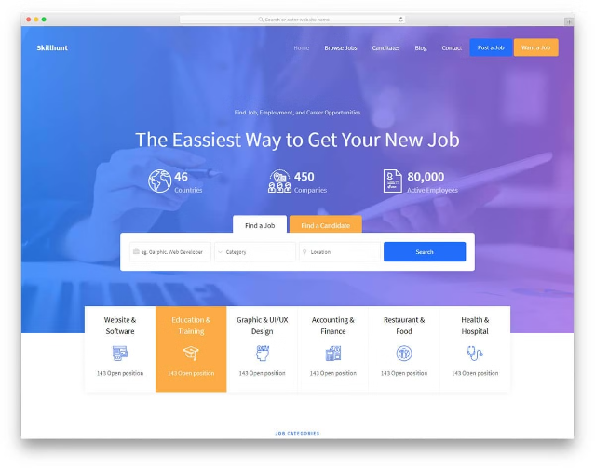

Job Searching Portal

Slide 2

Project Objective
We will be building Job searching portal using React (Frontend), Spring Boot Microservices (Backend), and MySQL (database)

Slide 3
Job portals are online platforms that connect employers with potential candidates. Knowing the features and functions of various portals can help you tailor your search effectively. Focus on platforms that align with your industry and career goals for better results.

Slide 4
Project Overview:
A job searching portal is a web-based platform that connects job seekers with employers, facilitating the process of finding and applying for job opportunities. It serves as a centralized platform where job seekers can explore job listings, submit applications, and manage their job search process

Slide 5

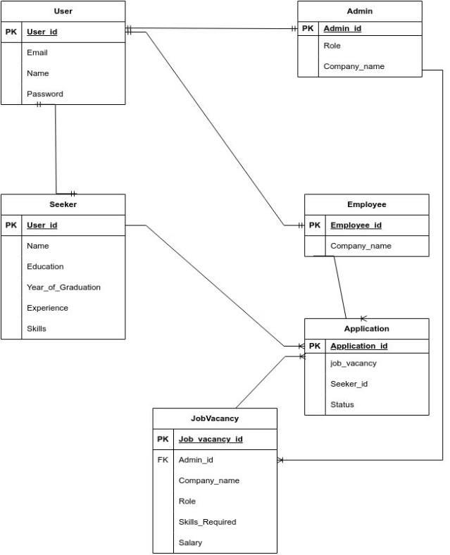
Entity Relationship Diagram

Slide 6
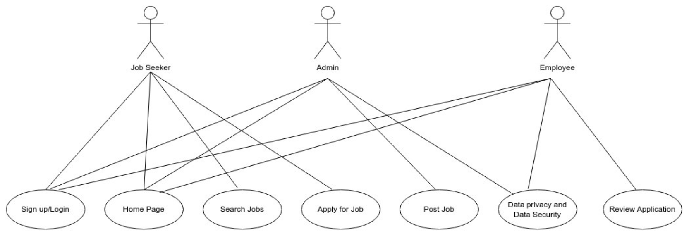
Use Case Diagram

